Slide 1

PROBABILITY (& Stats) MA 204
“It is remarkable that a science which began with the consideration of games of chance should have become the most important object of human knowledge.” Pierre Simon, Marquis de Laplace
Théorie Analytique des Probabilités

Slide 2

Searching the Web: Google’s PageRank
Random Walk on Graphs

Slide 3
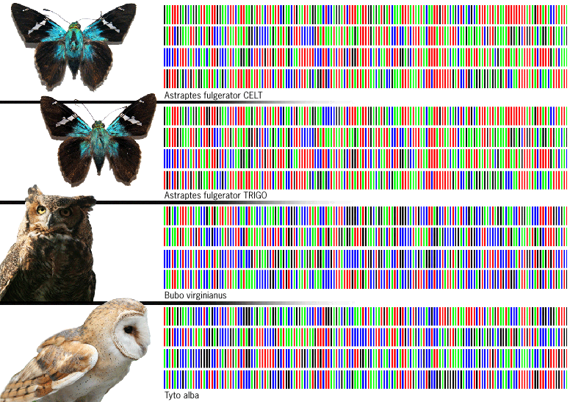
Patterns in DNA Sequences
Poisson Process

Slide 4

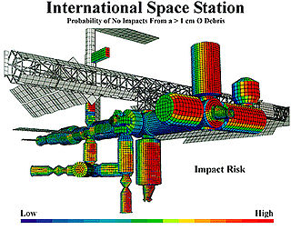
Risk Management
Using
probability to
identify, assess,
and prioritize
risks

Slide 5
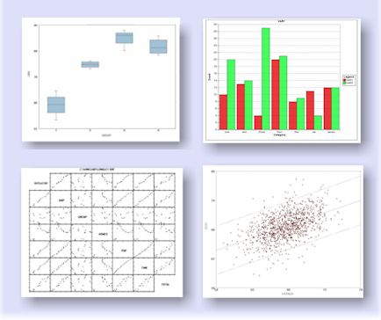
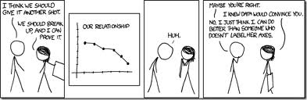
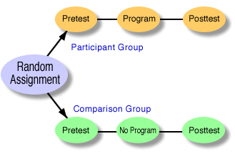
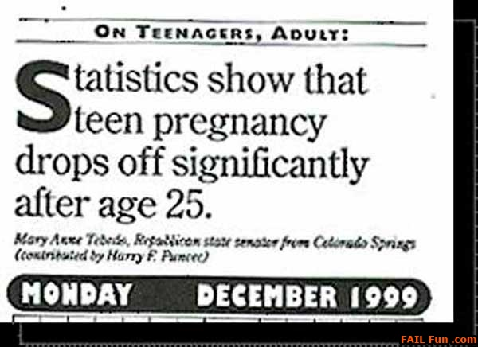
Statistics

Slide 6
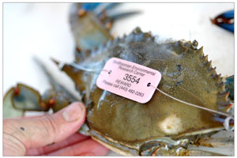
Estimating Animal Populations Capture-Tag-Recapture
Estimate N population size
Capture k animals, tag and release
Later recapture n animals at random
Let X = Number of tagged animals in the sample
To estimate population size N, X/n ≈ k/N, or N ≈ nk/X

Slide 7
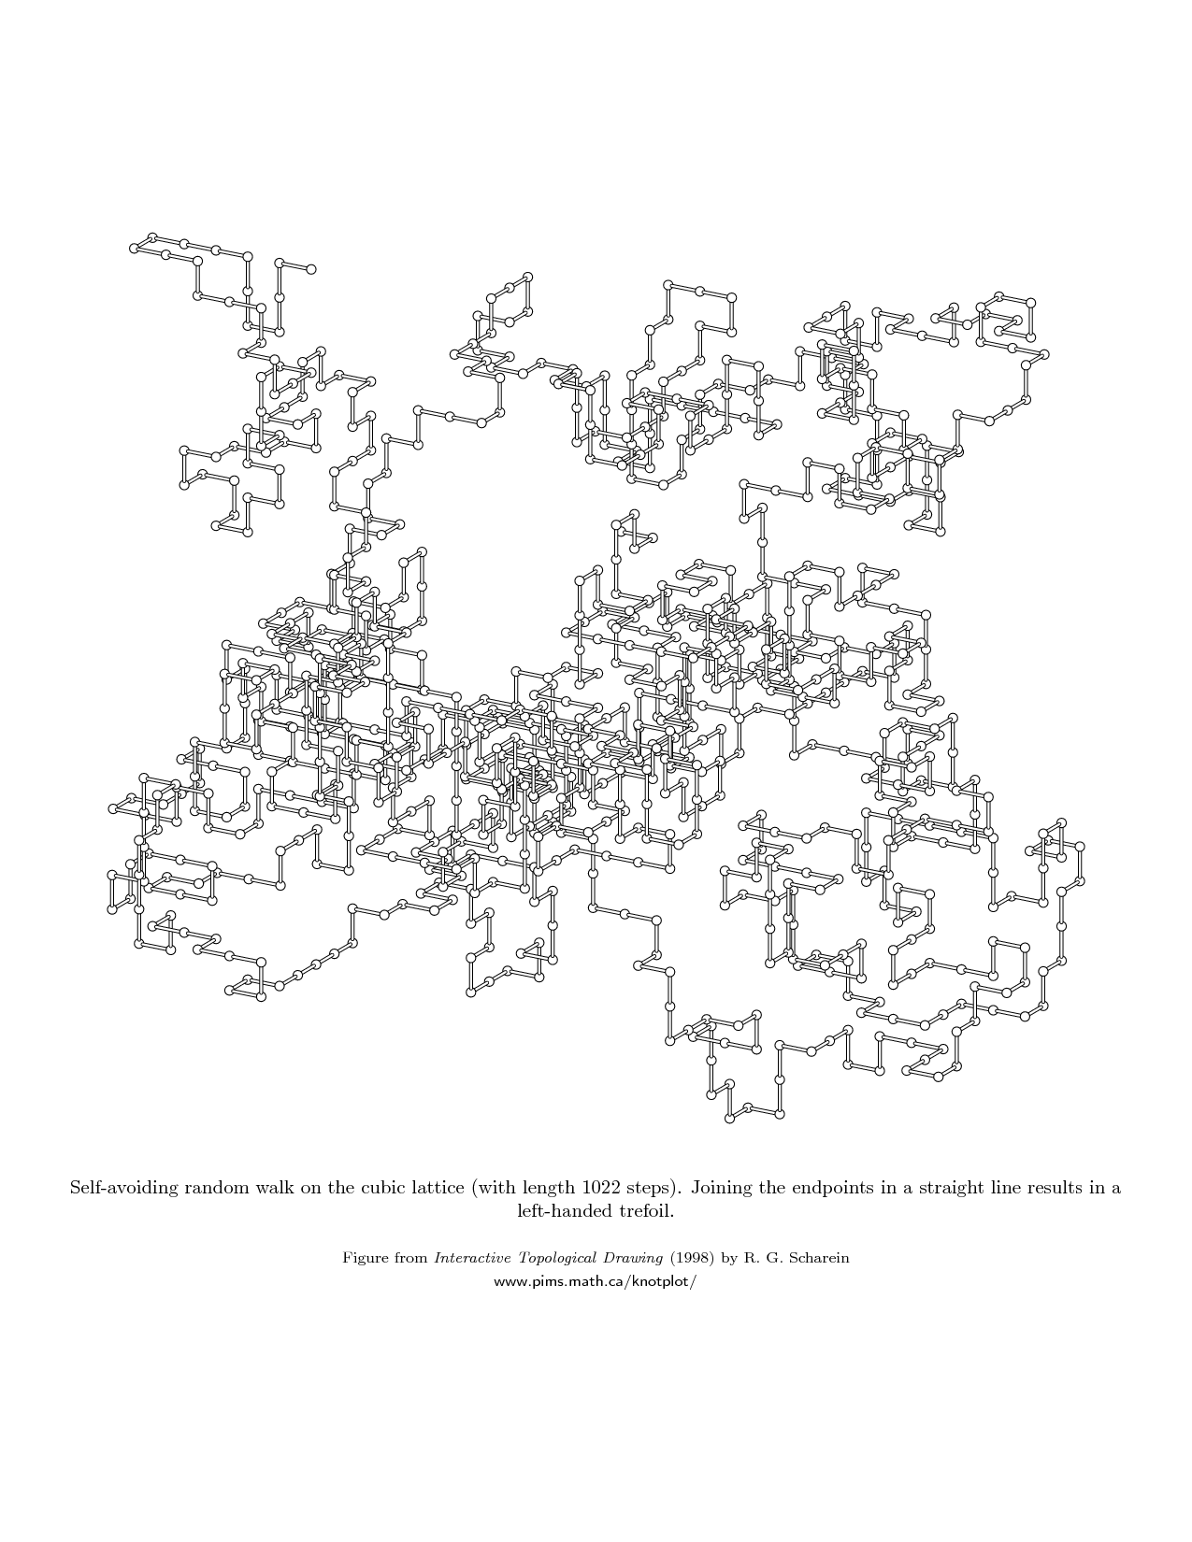
Models for Polymer Chains
Self-Avoiding Random Walks

Slide 8
Benford’s Law: An Experiment
Pick up a book, any book
Turn to a random page
On that page, point to the first number you see in the middle of some text
What is the first digit of that number?
What is the distribution of these first digits?

Slide 9
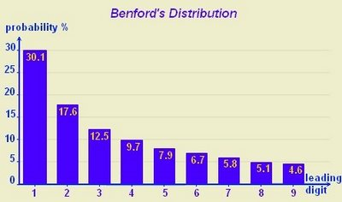
Electricity bills
Street addresses
Lengths of rivers
Death rates
Stock prices
Populations of cities
Mathematical constants
Honest tax form data

Slide 10
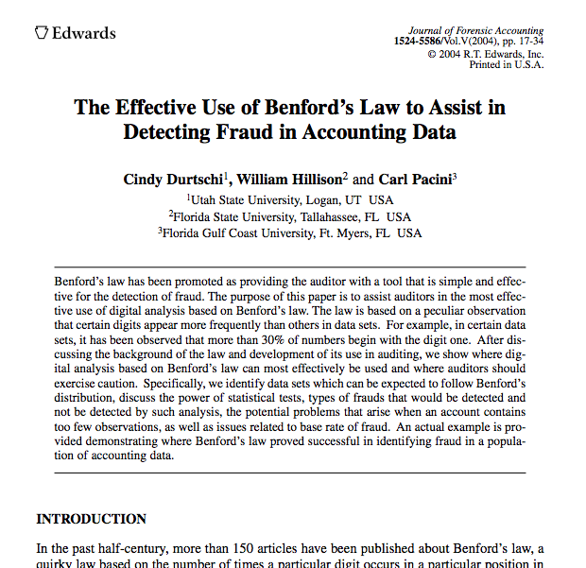
Benford’s ``First-Digit’’ Law
Prob(1st digit is k) = log₁₀(k+1) / log₁₀(k), for k = 1, …, 9
Evidence based on Benford’s law has been admitted in criminal cases at federal and state levels

Slide 11
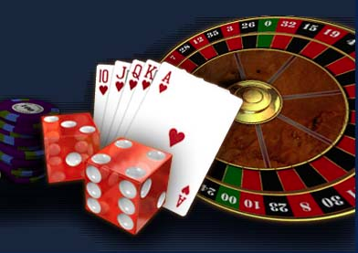
And of course . . .

Slide 12
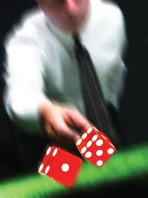
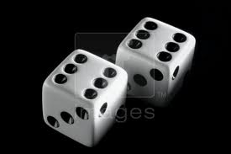
A 1654 Gambler’s Dispute
Would you pay $10 to play this game?
Roll two dice 24 times. If a pair of 6’s comes up you win $20. Is the game fair?
Find the probability of getting two 6’s in 24 rolls.
Fermat and Pascal worked on this problem, which led to the development of probability theory

Slide 13
What is a Probability?
P(Heads) = ?
1. Empirical, Relative Frequency: Flip lots of coins. About half of them come up heads.
P(Shark attack) = ?
2. Subjective Probability: Based on experience, information, and prior knowledge
P(A) = ?
3. How to put on mathematically sound basis?

Slide 14
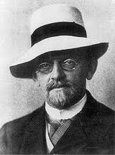
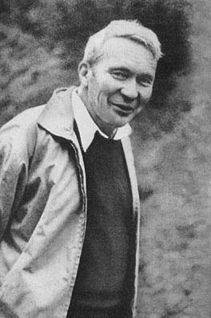
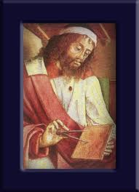
Modern Era: Axiomization
David Hilbert posed the problem at the Int’l Congress of Mathematicians in 1900
Andrei Kolmogorov developed the first rigorous approach to probability in 1933.
Probability built from basic axioms like Euclid's geometry.

Slide 15
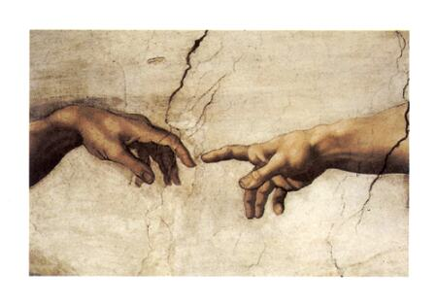

Mathematical Probability
Euclid’s system of
geometry begins
with a point
Probability begins
with a random experiment
Then definitions and axioms
Into a rigorous mathematical system

